Slide 1
IBM University Engagement Project Submission
“Exploring the Power of Agentic AI with IBM Granite and LangFlow”

Slide 2

Project Tile – VenturePilot AI
From Idea to Investment — Powered by AI
Domain of Project – Entrepreneurship & Business Intelligence
Student Name | Recent Passport Photo | Email ID | Mobile number [WhatsApp]
SAKTHI G |  | sakthi30116@gmail.com | 9942220999

Slide 3
Problem Statement – 20
Problem Statement: Startup Blueprint Generator Agent
The Challenge
Many people have great startup ideas but don't know how to turn them into successful businesses. Information about market research, competitors, funding, government schemes, and legal requirements is spread across different sources. Without proper guidance, entrepreneurs struggle to create a clear business plan and attract investors.
The Objective
Build an AI-powered Startup Blueprint Generator Agent that helps users convert their startup ideas into complete business plans using IBM Granite and RAG. The solution should:
Startup Analysis – Understand the user's startup idea and identify the business domain and target customers.
RAG Knowledge Retrieval – Retrieve market research, competitor information, government schemes, funding options, and legal requirements from reliable documents.
Business Blueprint Generation – Generate a complete business plan with a business model, budget, revenue model, marketing strategy, and implementation roadmap.
Funding Guidance – Recommend suitable investors, grants, incubators, and government schemes.
Interactive Dashboard – Display startup score, market potential, budget allocation, revenue forecast, competitor analysis, and roadmap through charts and visual cards

Slide 4
Proposed Solution: AI-Powered Startup Blueprint Generator Agent
The proposed solution is a multi-agent AI-powered Startup Blueprint Generator built using Python Flask, IBM watsonx.ai, IBM Granite Models, and IBM Cloud Object Storage to help entrepreneurs transform startup ideas into complete, investor-ready business blueprints. The system addresses challenges in business planning, market research, funding discovery, and legal compliance through an intelligent, modular architecture.
At its core, the solution uses a Retrieval-Augmented Generation (RAG) pipeline to retrieve relevant information from trusted sources such as Startup India resources, government policies, funding databases, incubator documents, market research reports, and legal guidelines stored in IBM Cloud Object Storage. These documents are embedded and retrieved to generate accurate, context-aware business recommendations using IBM Granite models.
The system consists of five key agents:
Startup Knowledge Agent retrieves market research, government schemes, funding opportunities, and legal information using RAG.
Business Planning Agent generates a complete business blueprint, including the Business Model Canvas, revenue model, budget estimation, and go-to-market strategy.
Market Intelligence Agent performs competitor analysis, customer segmentation, SWOT analysis, and market opportunity assessment.
Funding & Compliance Agent recommends investors, startup grants, incubators, accelerators, and relevant legal and regulatory requirements.
Startup Advisor Agent evaluates startup readiness, identifies risks, and provides AI-powered recommendations to improve business success and investor readiness.
The solution includes an interactive web dashboard built with Flask, Bootstrap, JavaScript, and Chart.js that visualizes startup success score, market potential, budget allocation, revenue projections, funding opportunities, competitor comparisons, and implementation roadmap. Users can also download their business blueprint as a professional PDF report.
IBM watsonx.ai powers the AI reasoning and business plan generation, while IBM Granite models provide intelligent analysis, summarization, and recommendations. IBM Cloud Object Storage securely stores the knowledge base, uploaded documents, and generated reports, enabling an efficient RAG workflow.

Slide 5
Technology Used
IBM Granite Model (e.g., ibm/granite-3-3-8b-instruct)
Used for understanding startup ideas, business reasoning, market analysis, business blueprint generation, competitor analysis, funding recommendations, and personalized startup guidance.
IBM watsonx.ai
Used for accessing and deploying IBM Granite models, prompt execution, AI inference, and secure model management to generate intelligent startup business plans.
IBM Cloud Object Storage
Used to store startup knowledge documents, market research reports, government scheme documents, legal resources, uploaded files, and generated business reports, enabling efficient document management for the RAG pipeline.
Retrieval-Augmented Generation (RAG)
Used to retrieve relevant information from trusted startup resources before generating responses, ensuring accurate, reliable, and context-aware business recommendations instead of relying only on the language model.
Vector Database (FAISS / ChromaDB)
Used to store document embeddings and perform semantic search for retrieving relevant market research, government schemes, funding information, competitor data, and legal documents during the RAG process.

Slide 6
Core Component Used
1) Chat Input
Allows users to enter their startup idea, business goals, industry, budget, target customers, and other business details through a user-friendly interface.
2) IBM watsonx.ai Agent
Processes user requests and coordinates the AI workflow using IBM Granite models to generate startup blueprints and business insights.
3) IBM Granite Model (Granite-3.3-8B-Instruct)
Performs natural language understanding, business reasoning, startup planning, market analysis, competitor analysis, funding recommendations, and business blueprint generation.
4) RAG (Retrieval-Augmented Generation)
Retrieves relevant information from the knowledge base before generating responses, improving the accuracy and reliability of the startup recommendations.
5) IBM Cloud Object Storage
Stores startup knowledge documents, government schemes, legal documents, market research reports, uploaded files, and generated business reports.
6) Vector Database (FAISS / ChromaDB)
Stores document embeddings and performs semantic search to retrieve the most relevant information for the RAG pipeline.

Slide 7
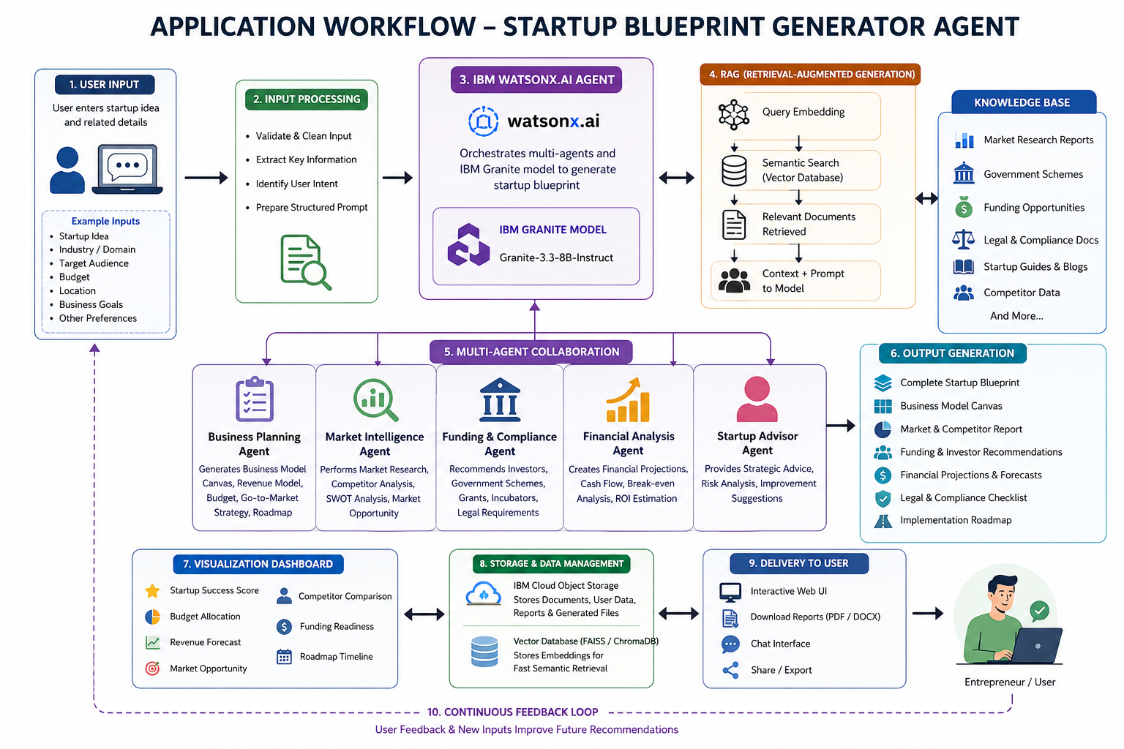
Application Workflow

Slide 8
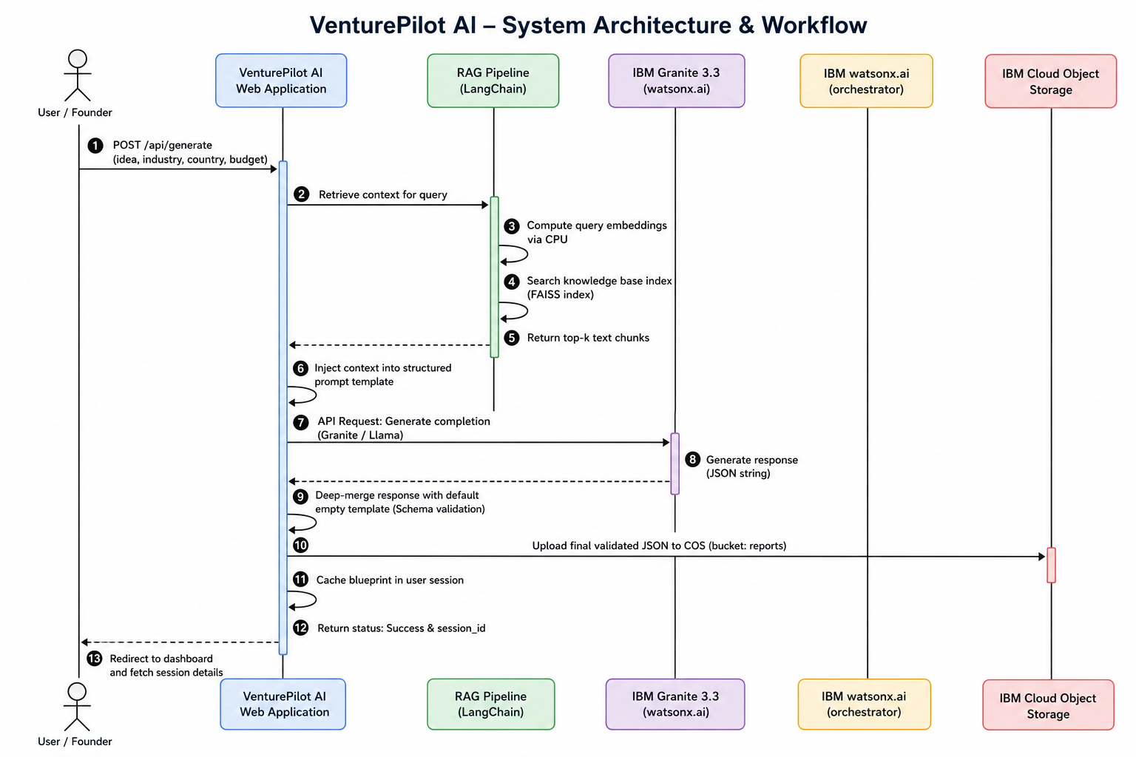
Architecture Blueprint

Slide 9

Role of Agentic AI in the solution
Role of Agentic AI in Startup Blueprint Generator Agent
Agentic AI enables the Startup Blueprint Generator to function as an intelligent, autonomous business advisor rather than a simple chatbot. Using IBM watsonx.ai and IBM Granite models, it coordinates multiple specialized agents to generate complete and personalized startup blueprints.
Each agent performs a specific task—such as retrieving market research, generating business plans, analyzing competitors, recommending funding opportunities, and identifying legal requirements—while working together to deliver accurate and actionable results. This multi-agent approach improves efficiency and ensures comprehensive business guidance.
Agentic AI also provides context awareness by understanding the user's startup idea, industry, business goals, budget, and target customers to generate tailored recommendations. It continuously adapts its responses based on user inputs, making the generated business blueprint more relevant and practical.
Additionally, the agents communicate with one another, enabling better decision-making, improved business planning, and intelligent recommendations throughout the startup journey.

Slide 10
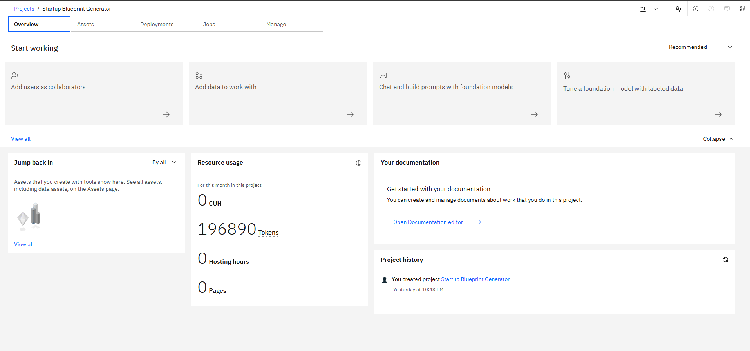
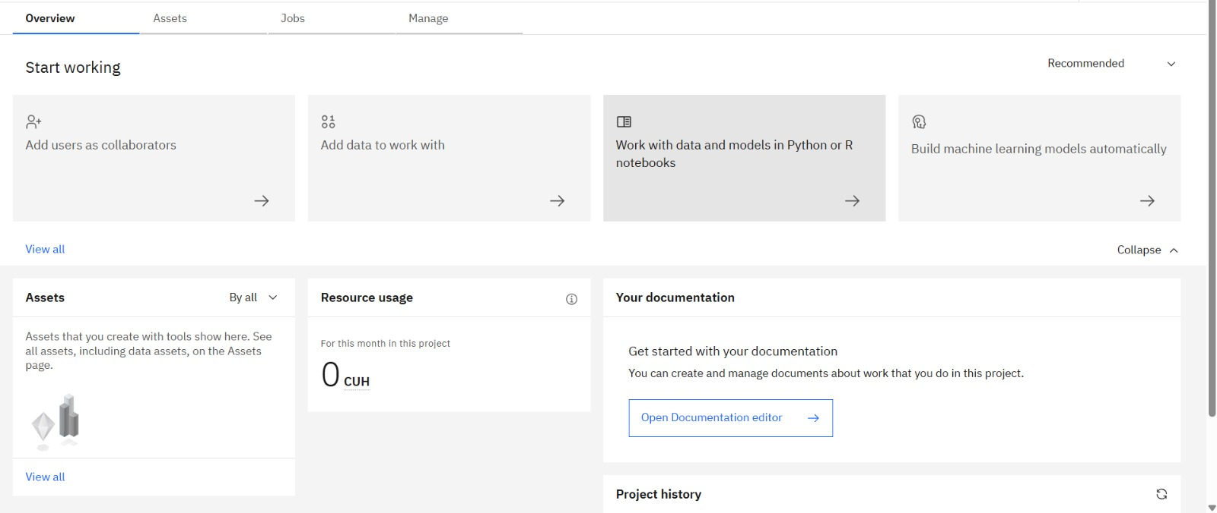
Token Usage
196890 Tokens are used
Before Prompt
After Prompt

Slide 11
Novelty and Uniqueness
The proposed Startup Blueprint Generator Agent stands out by combining Agentic AI, RAG, and intelligent business planning into a single AI-powered platform.
Multi-Agent Intelligence – Instead of a single chatbot, multiple specialized agents collaborate to perform market research, generate business plans, analyze competitors, recommend funding options, and provide legal guidance.
RAG-Based Accuracy – Integrates real-time knowledge retrieval with AI generation, ensuring business recommendations are based on reliable startup policies, market reports, government schemes, and funding resources.
Personalized Business Blueprints – Generates customized startup plans based on the user's business idea, industry, budget, target customers, startup stage, and business goals.
Interactive Business Dashboard – Presents AI-generated insights through visual dashboards, including Startup Success Score, Budget Allocation, Revenue Forecast, Market Analysis, and Funding Readiness.
Investor & Funding Guidance – Recommends suitable investors, startup grants, incubators, accelerators, and government schemes tailored to the startup.
Comprehensive Startup Planning – Goes beyond idea generation by providing Business Model Canvas, SWOT Analysis, competitor analysis, legal compliance guidance, and implementation roadmaps.
Scalable & Enterprise-Ready – Built using IBM watsonx.ai, IBM Granite Models, IBM Cloud Object Storage, and RAG, ensuring scalability, reliability, and secure AI-powered business planning.
This makes the solution a smart, adaptive, and proactive AI startup mentor, not just a basic business plan generator.

Slide 12
Git Hub Link
GitHub Repository Link:
https://github.com/sakthiganesan06/VenturePilot-AI
Deployed Link:
https://venturepilot-ai-jtqc.onrender.com

Slide 13
Future Scope
Live Market Data Integration – Integrate real-time market trends, startup news, competitor updates, and industry reports for more accurate business insights.
Investor & Mentor Matching – Connect entrepreneurs with suitable investors, incubators, accelerators, and industry mentors based on their startup profile and funding stage.
Financial Forecasting – Incorporate AI-powered financial projections, cash flow analysis, break-even analysis, and investment return estimation.
Pitch Deck Generation – Automatically generate professional investor pitch decks and presentation slides based on the generated business blueprint.
Multilingual Support – Support multiple regional and international languages to make the platform accessible to entrepreneurs worldwide.
Collaboration Workspace – Enable co-founders, mentors, and investors to collaborate, review, and edit startup plans in real time.
AI Startup Mentor – Introduce a conversational AI mentor that provides continuous guidance throughout the startup lifecycle, from idea validation to business growth.
Government & Funding Portal Integration – Integrate directly with startup portals, government schemes, and funding platforms to provide real-time eligibility checks and application support.
Predictive Startup Success Analysis – Use machine learning models to predict startup success probability based on market trends, financial planning, and business strategies.
Mobile Application – Develop Android and iOS applications to provide entrepreneurs with AI-powered startup guidance anytime and anywhere.

Slide 14
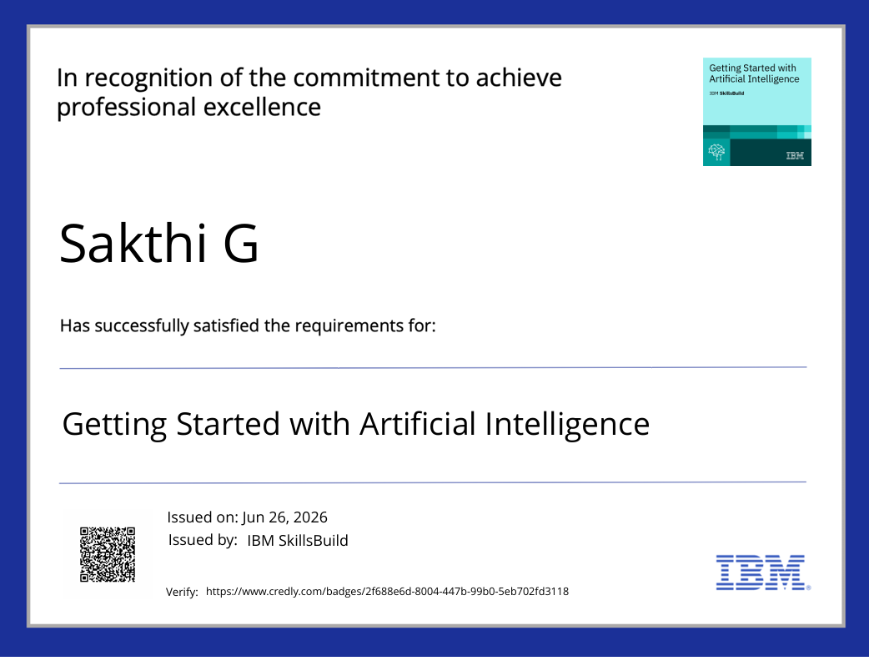
Certificates Earned:

Slide 15
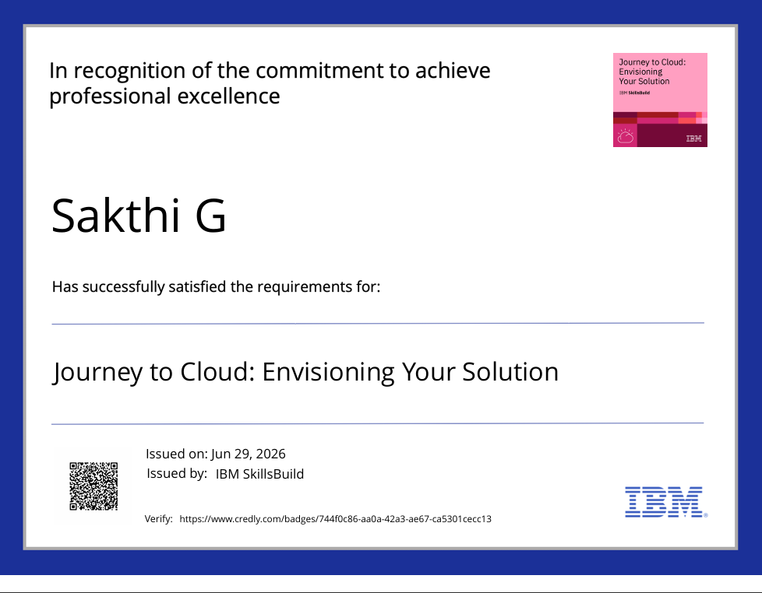
Certificates Earned:

Slide 16
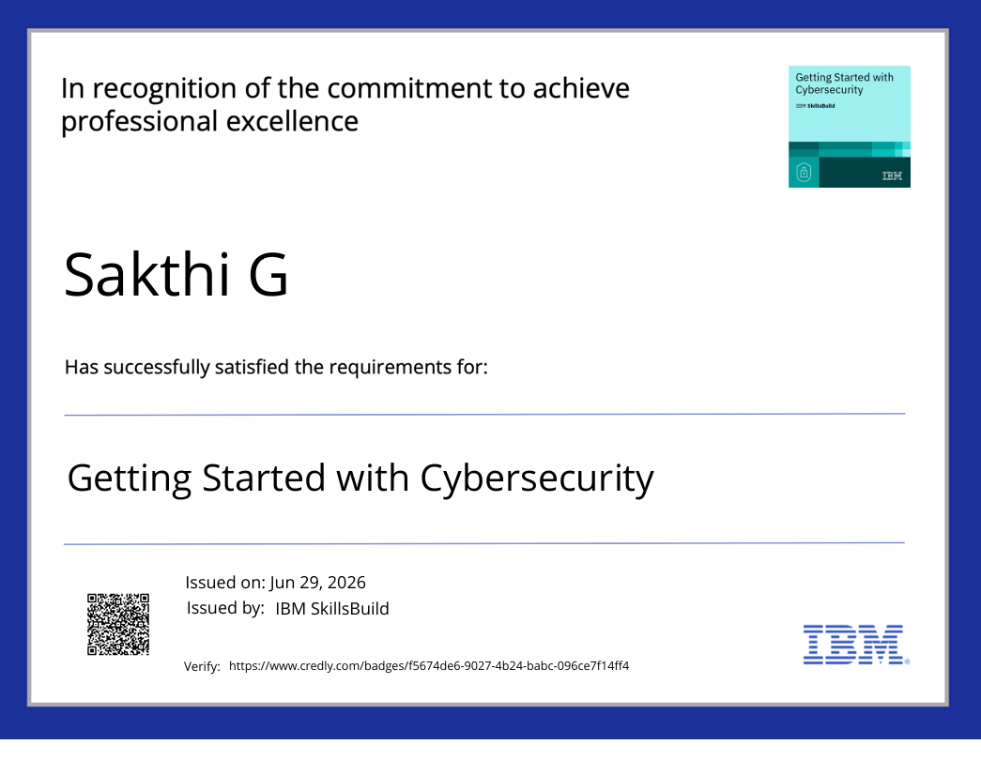
Certificates Earned:

Slide 17
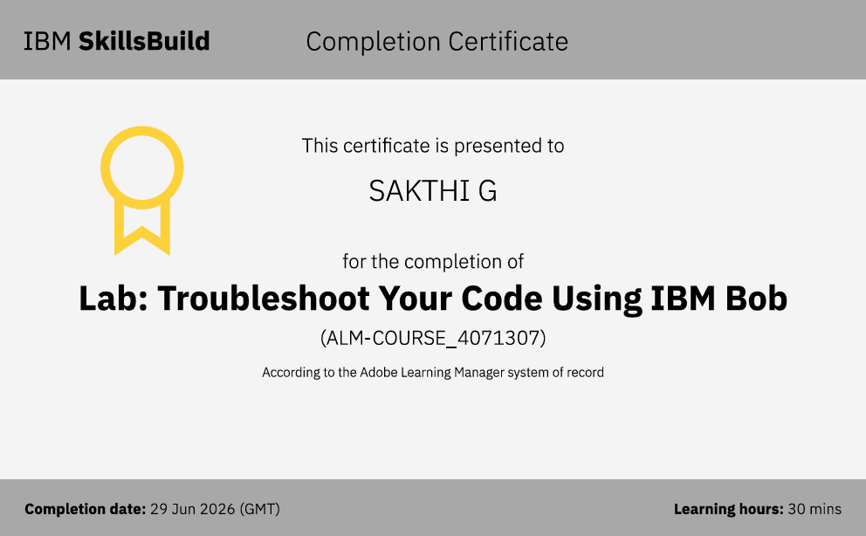
Certificates Earned:​

Slide 18
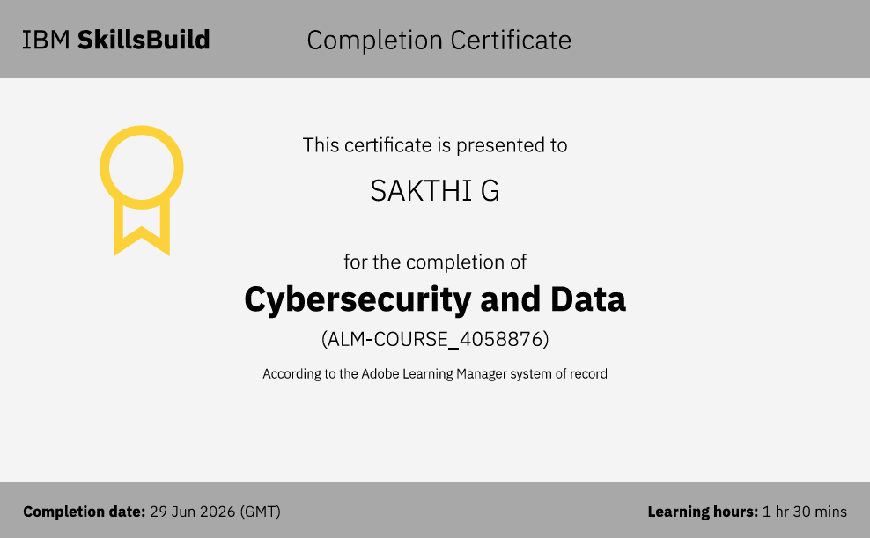
Certificates Earned:​

Slide 19
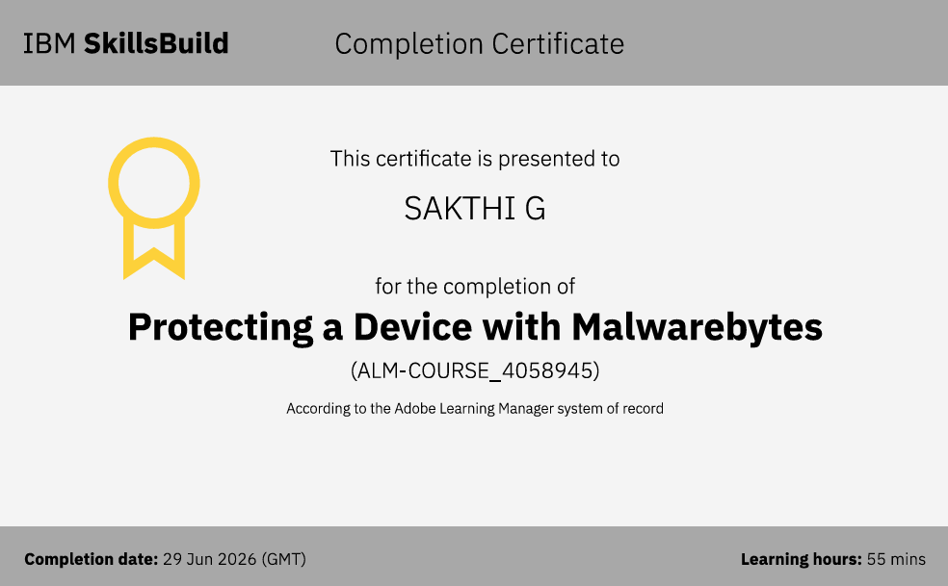
Certificates Earned:​

Slide 20
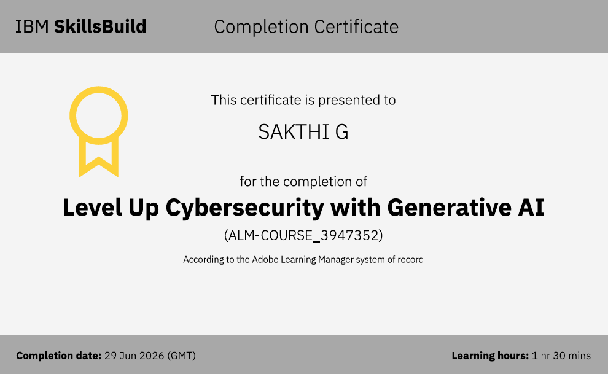
Certificates Earned:​

Slide 21
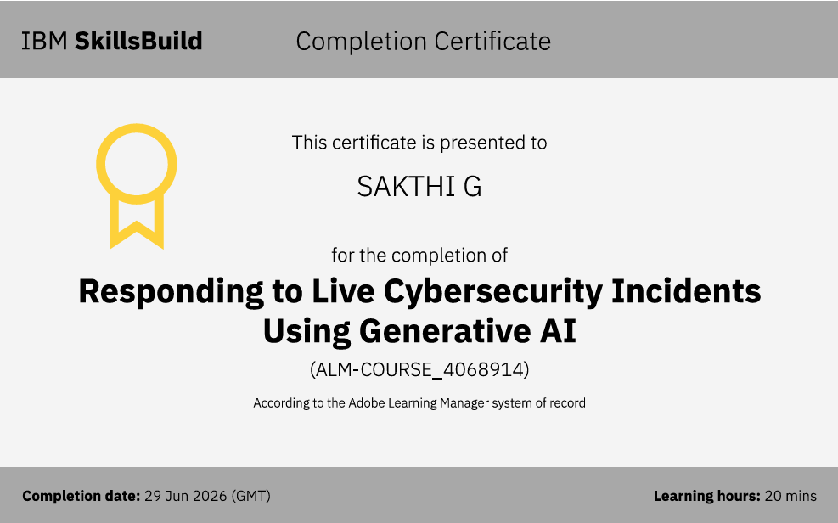
Certificates Earned:​

Slide 22
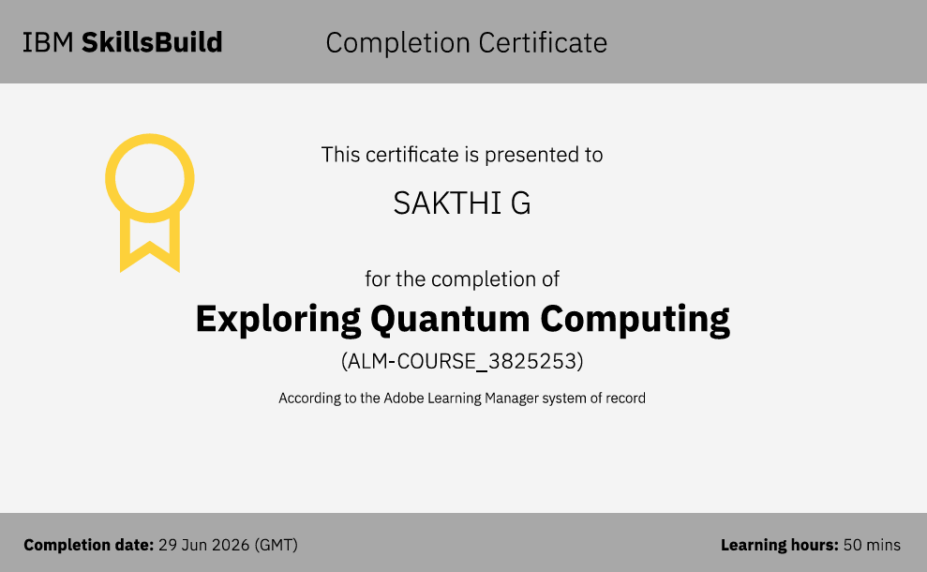
Certificates Earned:​

Slide 23
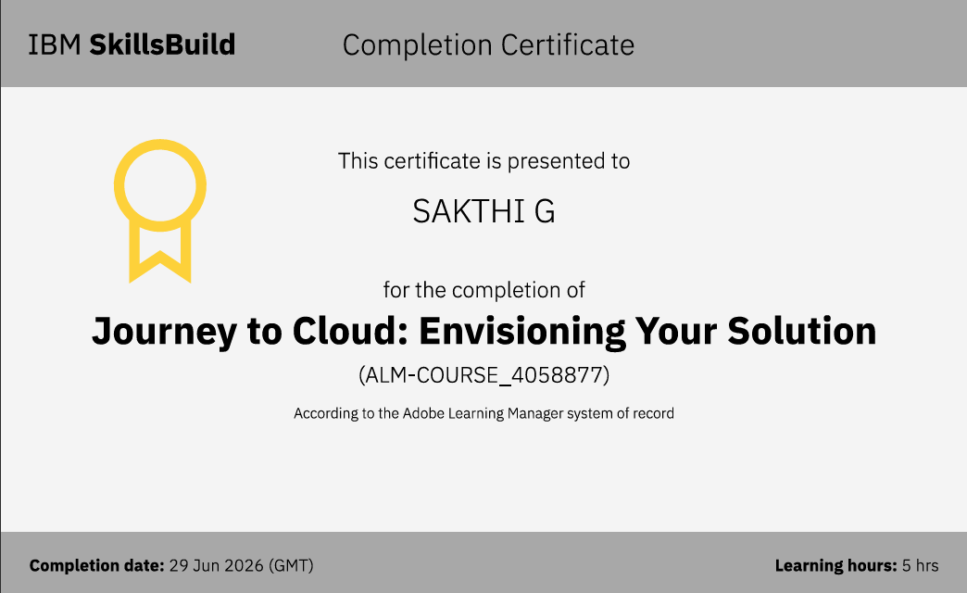
Certificates Earned:​

Slide 24


